Slide 1
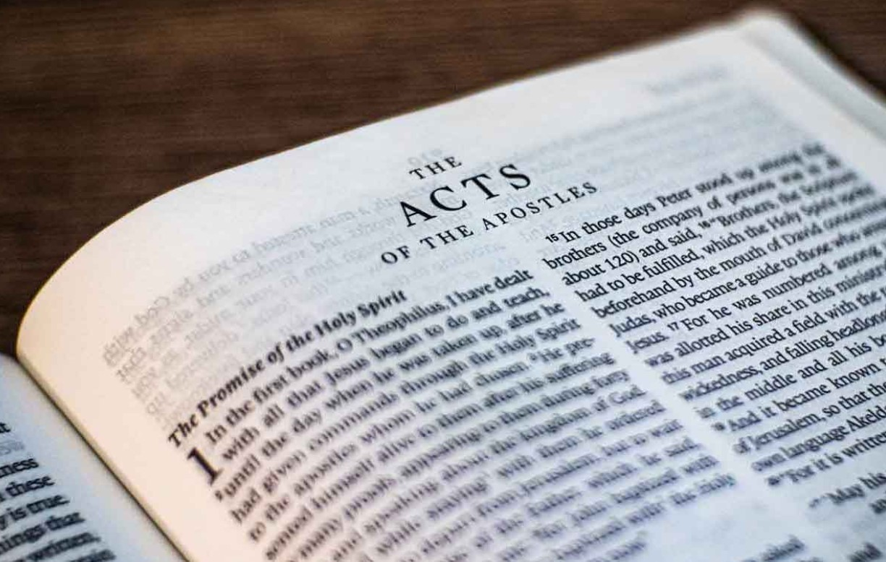
Go Tell The Good News
Acts – Part II

Slide 2
1)
2)
3)
4)
5)
6)
7)
8)
9)
10)
11)
12)
13)
14)
15)
Ascension & Appointment
Philippian Prison
16)
17)
18)
19)
20)
21)
22)
23)
24)
25)
26)
27)
28)
Pentecost & Peter’s Preaching
Addressing Athens
Lame Man & Lesson
Achaia, Antioch, & Apollos
Restrained, Released, & Request
Deception & Detention
Seven Selected
Stephen Stoned
Samaria & Salvation
Saul Saved & Dorcas Delivered
Cornelius Converted
Report & Relief
A
Persecution, Peter, & Pride
CTS
Antioch to Iconium
F
Iconium to Antioch
ACTS
Disagreement & Decision
Alliteration Memory Statements To Help Recall Chapter Content

Slide 3
1)
2)
3)
4)
5)
6)
7)
8)
9)
10)
11)
12)
13)
14)
15)
Ascension & Appointment
Philippian Prison
16)
17)
18)
19)
20)
21)
22)
23)
24)
25)
26)
27)
28)
Pentecost & Peter’s Preaching
Addressing Athens
Lame Man & Lesson
Achaia, Antioch, & Apollos
Restrained, Released, & Request
Re-baptism, Repentance, & Riot
Deception & Detention
Macedonia & Miletus
Seven Selected
Jerusalem & Jewish Mob
Stephen Stoned
Review & Rejection
Samaria & Salvation
Council & Conspiracy
Saul Saved & Dorcas Delivered
Caesarean Confinement
Cornelius Converted
Appeal & Agrippa
Report & Relief
A
Review & Ridicule
Persecution, Peter, & Pride
Marooned On Malta
CTS
Antioch to Iconium
F
Rescued To Rome
Iconium to Antioch
ACTS
Disagreement & Decision
Alliteration Memory Statements To Help Recall Chapter Content

Slide 4
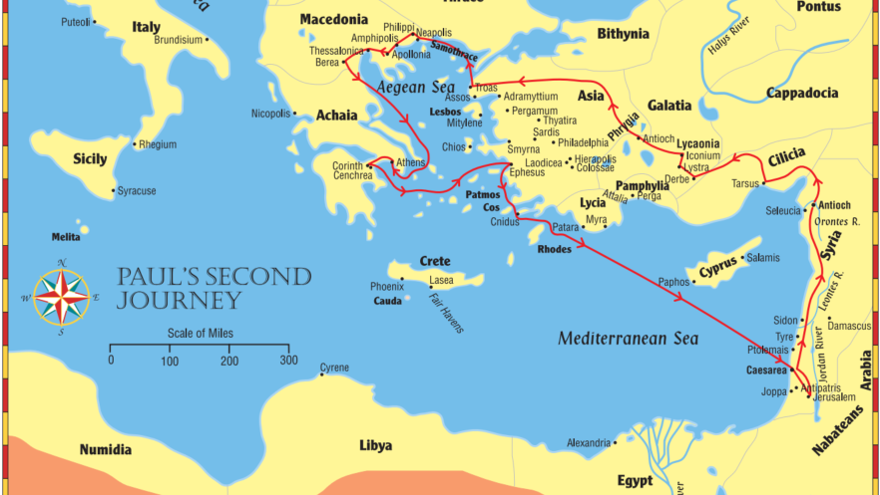
Reasoned with Jews; some were converted; Others attacked Jason’s house
Lydia converted
Beaten & Imprisoned
Jailer converted
Vision from Macedonia
More fair minded; searched the scriptures
Timothy joins Paul & Silas
Paul addressing the Areopagus (judgment seat)
Division over John Mark
Notes:
Summary of Paul’s 2nd Journey (through Athens); today’s lesson will see Paul in Corinth

Slide 5
Paul’s speech at the Areopagus
Summary
Verses 22-28
The true God:
Creator of all things
Completely independent of men
God does not need anything men have
Man is totally dependent upon God for their existence
God rules in the affairs of men
The conduct of God among men is calculated to draw men to seek Him, though He is not far from each one

Slide 6
Paul’s speech at the Areopagus
Summary
Verses 29-31
Since we are the offspring of God, do not conceive of God as an object of gold or silver or stone shaped by men’s tools and art.
God commands that all men everywhere should repent.
God will judge all men by the one He has chosen, Jesus Christ
He demonstrated that Christ is His choice to be Judge by raising Him from the dead

Slide 7
Reasoned with Jews; some were converted; Others attacked Jason’s house
Lydia converted
Beaten & Imprisoned
Jailer converted
Summary
Vision from Macedonia
More fair minded; searched the scriptures
Timothy joins Paul & Silas
Paul addressing the Areopagus (judgment seat)
Division over John Mark
Notes:
Summary of Paul’s 2nd Journey (through Athens); today’s lesson will see Paul in Corinth

Slide 8
Reasoned with Jews; some were converted; Others attacked Jason’s house
Lydia converted
Beaten & Imprisoned
Jailer converted
Vision from Macedonia
More fair minded; searched the scriptures
Timothy joins Paul & Silas
Paul addressing the Areopagus (judgment seat)
Notes:
Summary of Paul’s 2nd Journey (through Athens); today’s lesson will see Paul in Corinth

Slide 9
Today’s class:
Acts 18:1-22
Ministering at Corinth
Summary of Paul’s letters to the Thessalonians
Paul returns to Antioch
End of Paul’s 2nd missionary journey

Slide 10
Theme verse
Acts 1:8
“But you shall receive power when the Holy Spirit has come upon you; and you shall be witnesses to Me in Jerusalem, and in all Judea and Samaria, and to the end of the earth.”

Slide 12
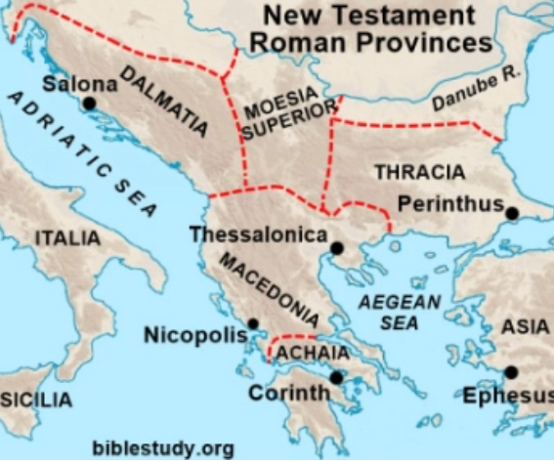
Modern day Greece

Slide 14
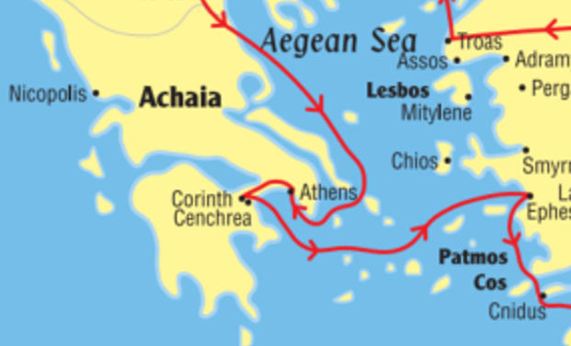
Corinth: about 45 miles west of Athens

Slide 15
Corinth:
Corinth was a large, diverse, and wealthy trade hub known for its cosmopolitan yet morally corrupt culture.
Geographically:
  Ancient Corinth was strategically situated on the narrow Isthmus of Corinth, the land bridge connecting the Peloponnese peninsula to mainland Greece.

Slide 16
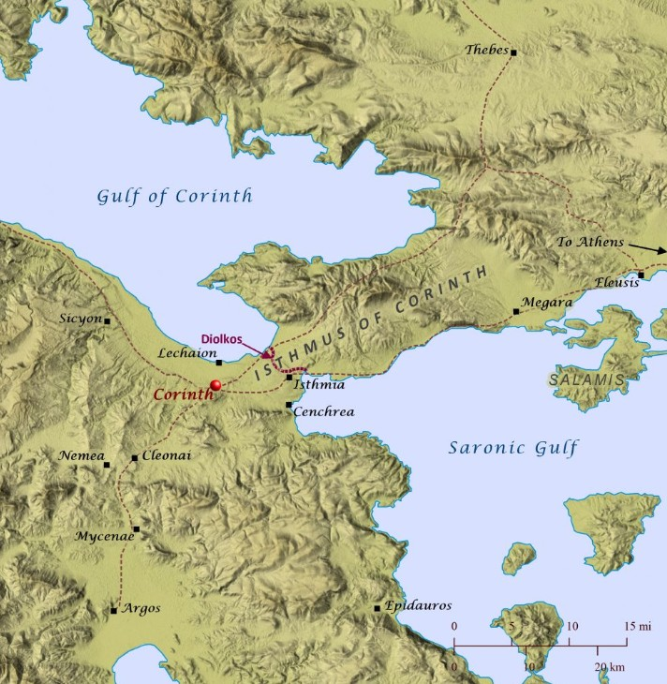
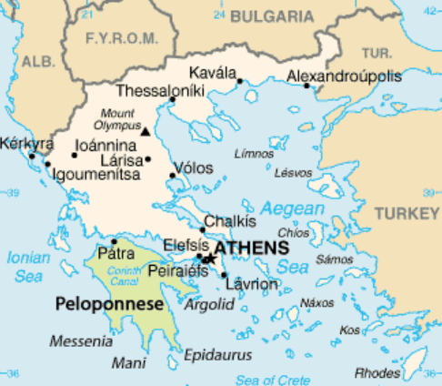
Corinth:
Trade from the West
(Iconian Sea)
Corinth was a large, diverse, and wealthy trade hub known for its cosmopolitan yet morally corrupt culture.
Ancient Corinth was strategically situated on the narrow Isthmus of Corinth, the land bridge connecting the Peloponnese peninsula to mainland Greece.
Trade from the East
(Aegean Sea)

Slide 17
Diolkos:
The Diolkos was an ancient paved trackway near Corinth, Greece, that allowed boats to be transported overland across the Isthmus of Corinth, avoiding the dangerous circumnavigation of the Peloponnese peninsula. It functioned from around 600 BC until the middle of the 1st century AD, serving both commercial and military purposes.

Slide 18
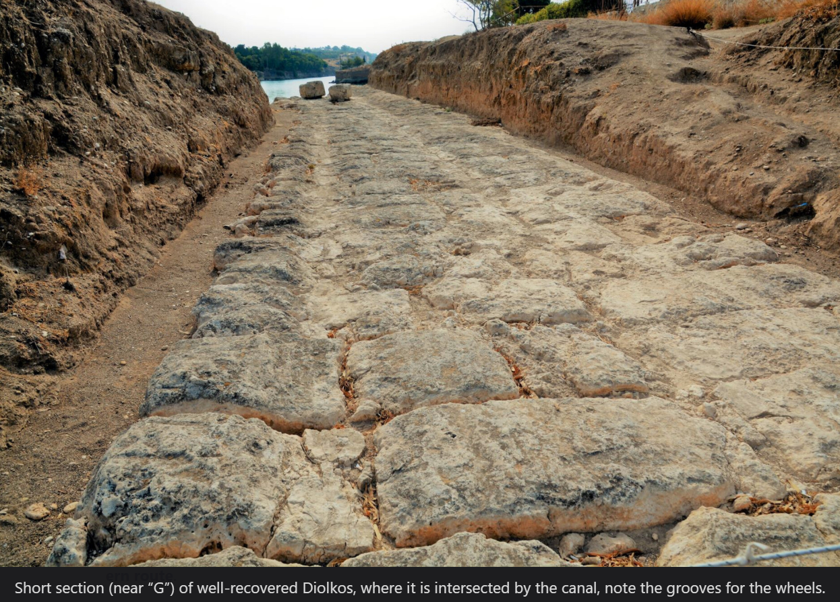
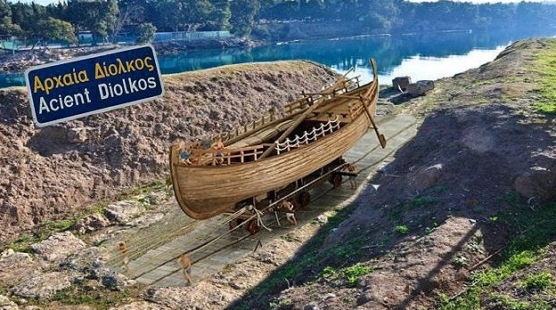
Diolkos: built approximately 600 B.C.

Slide 19
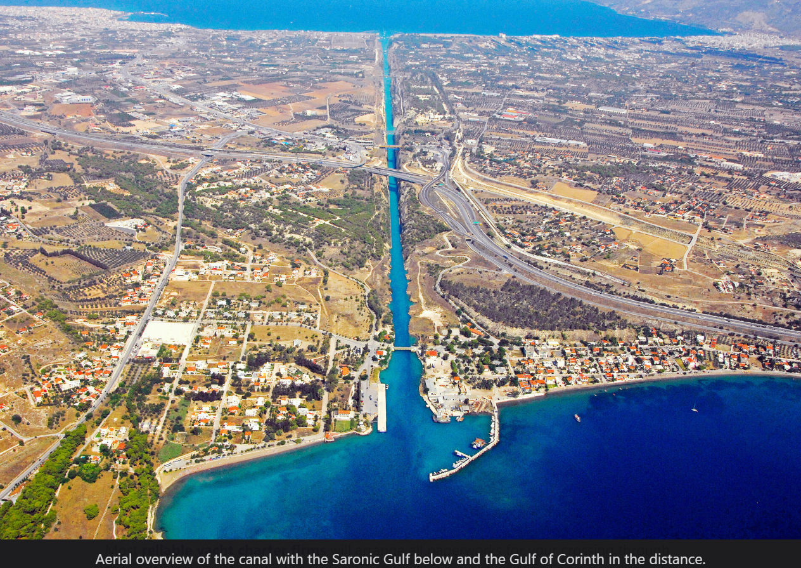
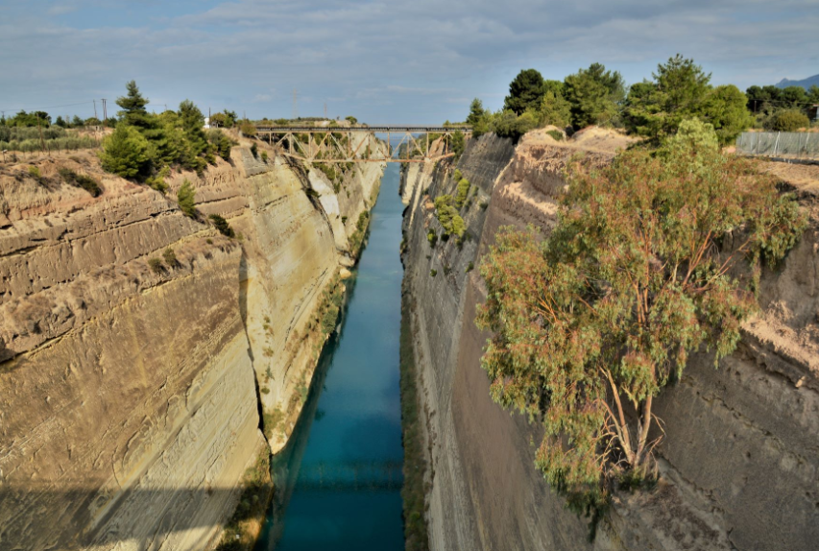
Corinth Canal:
Initiated in 67 A.D. by Nero
Finally completed in 1893
https://leonmauldin.blog/tag/diolkos/

Slide 20
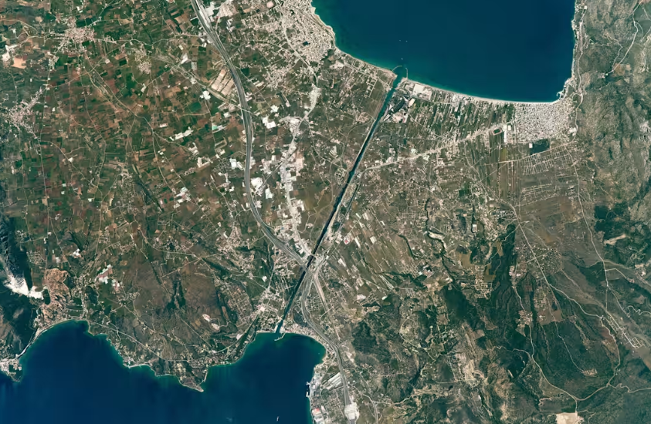
Corinth Canal:
This photograph, taken by an astronaut aboard the International Space Station, shows the straight line of the Corinth Canal as it crosses a narrow isthmus between mainland Greece (right) and the Peloponnese Peninsula.
NASA/Expedition 51 crew

Slide 21
Corinth:
Historically:
  Metal tools have been found that reveal occupation during the Early Bronze Age (between 3000 B.C. and 2000 B.C.).
  350-250 B.C. → Largest and most prosperous city in Greece
  144 B.C. → Destroyed by L Mummius, the Roman consul, who burned the city, killed the men, and sold the women and children into slavery. Desolate for 100 years
  44 B.C. → rebuilt by Julias Ceasar and quickly became an important city in the Roman Empire

Slide 22
Corinth:
Culturally:
  Ancient Corinth was known across the ancient world for its wealth, luxury, and moral laxity.
  The Corinthians were notorious for their hedonism and immorality. Brothels, drunkenness, gluttony, and sexually explicit artwork could all be found in Corinth. In fact, the Greek verb “to act like a Corinthian” (korinthiazesthai) was synonymous with practicing fornication.
  On the Acrocorinth, a monolithic rock overlooking the ancient city of Corinth, a temple to the goddess Aphrodite was built that housed up to 1000 slave prostitutes who were offered as living sacrifices to the goddess

Slide 23
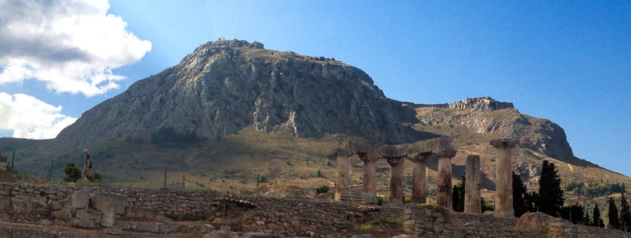
Acrocorinth (Upper Corinth) from the ancient city of Corinth

Slide 24
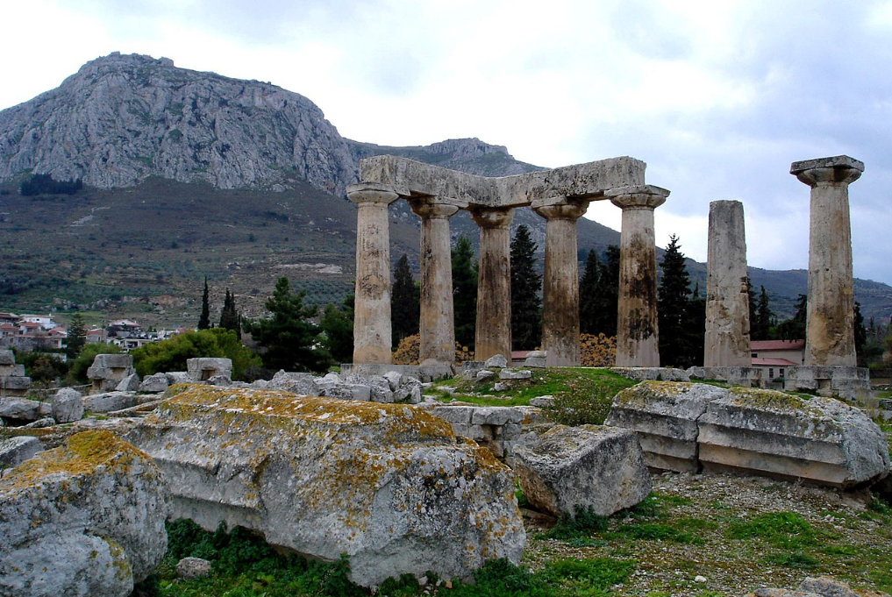
From ancient Corinth: Temple of Apollo with Acrocorinth in the background
Notes:
From ancient Corinth: Temple of Apollo with Acrocorinth in the background

Slide 25
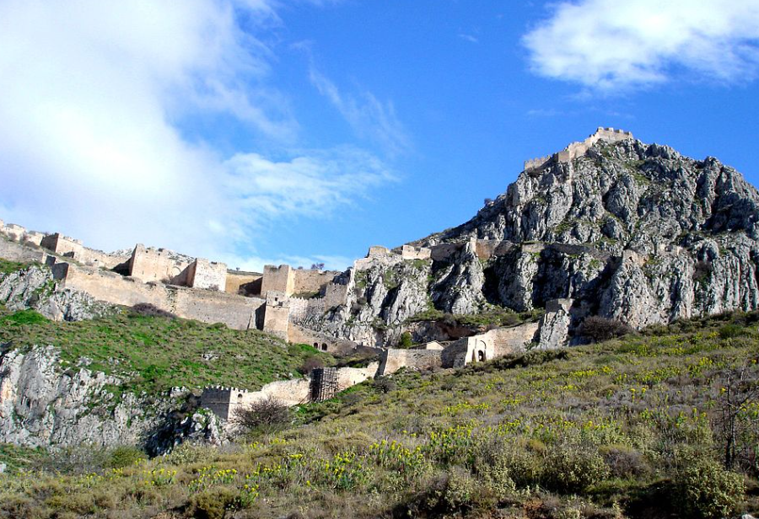
View of Acrocorinth walled gates, as rebuilt by the Venetians.

Slide 26
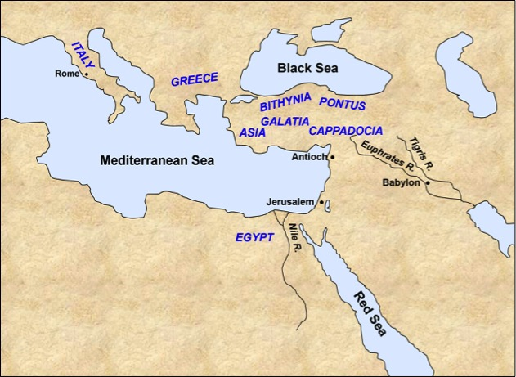
Paul in Corinth:
Paul finds Aquila and Priscilla, Jews who had recently come from Italy (due to Claudius’ (reigned A.D. 41-54) expulsion of Jews from Rome)

Slide 27
Paul in Corinth:
Paul finds Aquila and Priscilla, Jews who had recently come from Italy (due to Claudius’ (reigned A.D. 41-54) expulsion of Jews from Rome)
Paul stays with them as they were of the same trade: tent makers
Paul reasons in the synagogue every Sabbath and persuades both Jews and Greeks
Silas and Timothy arrive from Macedonia; Paul is compelled (pressed, urged) by the Spirit and testifies to the Jews that Jesus is the Christ

Slide 28
Paul in Corinth:
The Jews opposed him and blasphemed him
Paul “shook his garments” and told them, “Your blood be upon your own heads; I am clean. From now on I will go to the Gentiles.”
  Ref: Mt. 10:14; Ezek. 33:1-4, 9

Slide 29
Paul in Corinth:
“Do not be afraid, but speak, and do not keep silent; for I am with you, and no one will attack you to hurt you; for I have many people in this city.”
Paul enters the house of Justus, a worshiper of God, whose house was next to the synagogue
Crispus, ruler of the synagogue, believes with his household
Many of the Corinthians, hearing, believed and were baptized
The Lord speaks to Paul and encourages him to continue to evangelize to the people
Paul continues to live and preach in Corinth for 18 months

Slide 30
Paul in Corinth:
During his time in Corinth, Paul is brought to the judgment seat when Gallio was proconsul of Achaia
The Jews are trying to instigate an uproar against Paul, but Gallio does not want to hear any issues about words, names, and issues with Jewish law and drives them from the judgement seat
The Greeks take Sosthenes, the ruler of the synagogue, and beat him; Gallio takes no notice

Slide 31
Paul returns to Antioch
Paul decides to return to Antioch; he sails for Syria and Priscilla and Aquila travel with him to Ephesus
At Cenchrea, port city about 8 miles east of Corinth, Paul has his hair cut off “for he had taken a vow”
Upon arrival in Ephesus, Paul leaves Aquila and Priscilla there and proceeds to enter the synagogue and reason with the Jews
They wished for Paul to stay but he did not consent as he was wanting to keep the feast in Jerusalem.
He states that he will return, God willing

Slide 32
Paul returns to Antioch
Paul lands at Caesarea, goes up and greets the church (in Jerusalem), and then goes down to Antioch

Slide 34
Paul’s letters while in Corinth
After Silas and Timothy arrive in Corinth, Paul writes letters to the church in Thessalonica encouraging them to stand strong against great affliction

Slide 35
Summary of 1st Thessalonians
Chapter 1:
Paul, Silas, and Timothy were thankful that the brethren had turned from their idols
They were converting in spite of great affliction
Paul encourages them to be good examples to others
Chapter 2:
Paul’s example of persevering through persecution
The brethren received their message as the word of God, not as the word of men.
They became imitators of the churches in Judea

Slide 36
Summary of 1st Thessalonians
Chapter 3:
Paul was concerned that persecution might make you give up & sent Timothy to encourage them
Timothy returned with a good report; Paul was comforted
May God make them increase and abound in love to one another
Chapter 4:
Paul encourages them to walk as to please God
Paul gives comfort for those who have died, or will die, in faith and encouragement for those who remain

Slide 37
Summary of 1st Thessalonians
Chapter 5:
Exhorts them to remain faithful to the Lord!

Slide 38
Summary of 2nd Thessalonians
Chapter 1:
Be comforted in your afflictions; God will avenge
Chapter 2:
Don’t be disturbed by false teaching regarding the Lord’s second coming
Stand fast, hold the traditions which they were taught
Chapter 3:
Pray for the Lord’s work to be done
Deal with those who walk disorderly
Don’t grow weary in doing good

